Slide 1


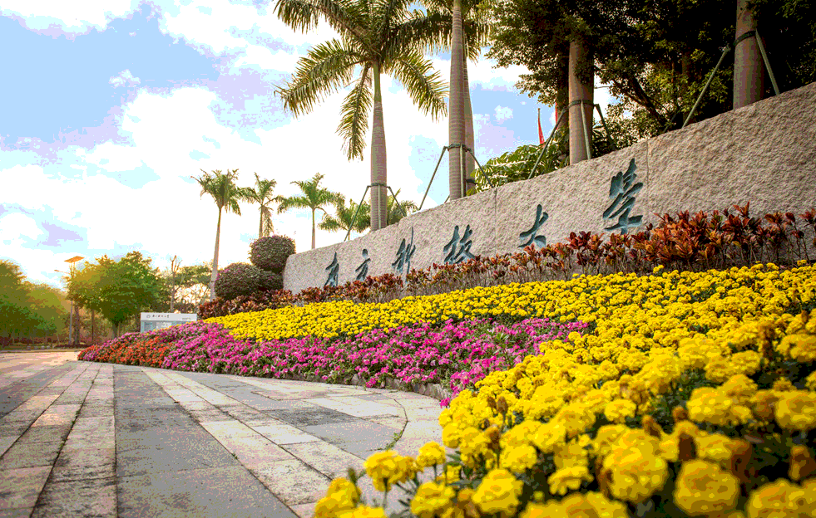

使用Python 处理国际空间站单反相机照片
报告人：张斐
20201230

Slide 2
CONTENTS
原理介绍
1
2
程序包介绍
数据处理方法
3
4
参考文献
2

Slide 3
1.原理介绍
方法：
A method to do this using the star field in the images, and how the reconstructed pointing can then be used to georeference the images to a similar level of accuracy in existing all-sky camera images.
工具：
Auromat
Astrometry.net
图像格式选择：
Images are typically available in JPEG and RAW format.
using the RAW images rather than the JPEGs is that the JPEGs are optimised frame by frame, so are not always consistently processed across a sequence, making comparisons difficult.
Another advantage of using the RAW images is that dead and hot pixels can be removed more easily from the images
3

Slide 4
1.原理介绍
1.Automatic georeferencing technique
In order to make the astronaut photographs useful for research, their pointing must be reconstructed and the images must then be projected onto a latitude–longitude grid, assuming a fixed emission height for the aurora. Pointing reconstruction is accomplished through automatically identifying the star field in each image using the Astrometry.net software
(Lang et al., 2010). However, the software is not designed for use on images that contain sections of the Earth, the aurora and indeed parts of the structure of the ISS, so some preprocessing is needed before the images can be successfully georeferenced.
These preprocessing steps are described below.
Image pre-processing
Lens distortion correction
Hot/dead pixel repair
Image masking
Contour detection of star field areas
Refining the mask
gi-5-289-2016.pdf (copernicus.org)
4

Slide 5
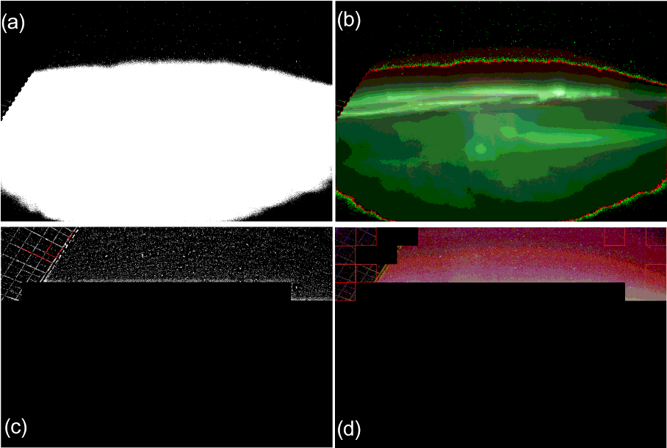
1.原理介绍
1.Automatic georeferencing technique
Stages of the automatic image masking process.
(a) The image is reduced to two colours to identify dark regions likely to be star field.
(b) The resulting contour is applied to the original image.
(c, d) Image blocks not detected as star field are masked and edge
detection is applied to detect and mask linear features likely to be space station structure.
5

Slide 6
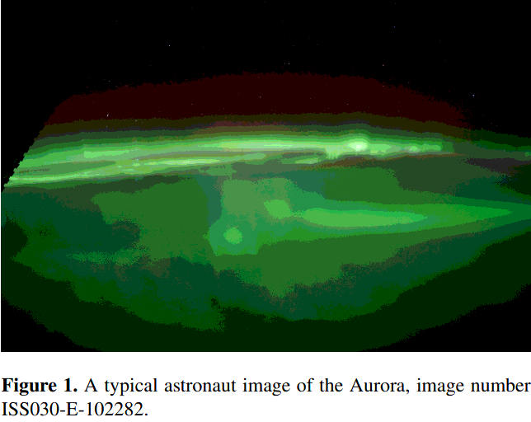
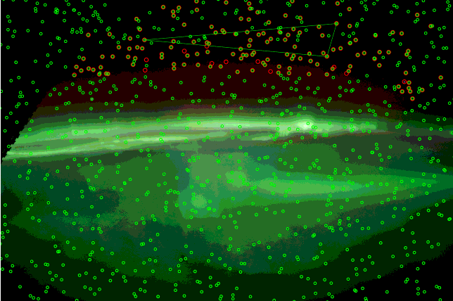
1.原理介绍
2. Astrometry
Results of applying astrometry.net to the image in Fig. 1. Green circles represent the locations of catalogue stars, red circles stars that have been detected in the image and identified. The triangle with three of the identified stars at its vertices shows one of the “Quads” used by astrometry.net to deduce the plate scale and orientation of the image.
6

Slide 7
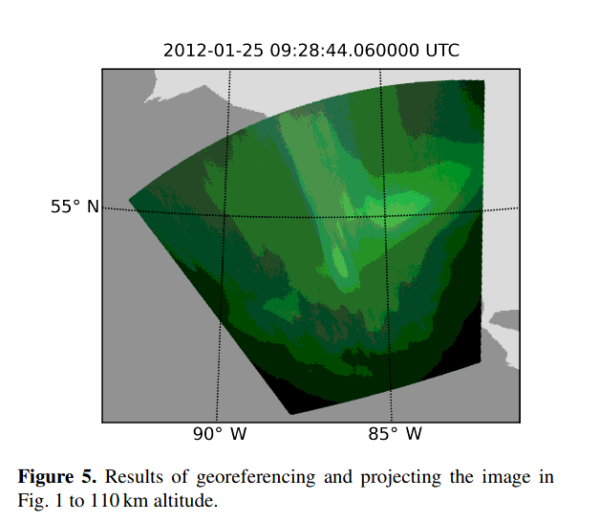
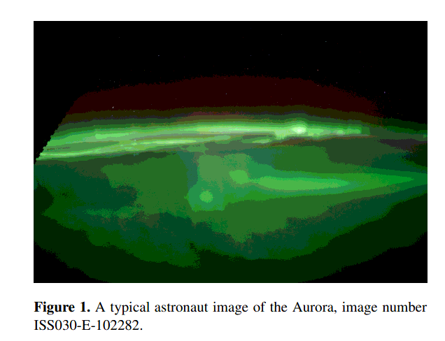
1.原理介绍
3. Mapping
7

Slide 8
1.原理介绍
3. Mapping
可以使用图像时间戳和相应的ISS位置在任意高度进行地理参考，从而为每个像素生成大地纬度和经度坐标中心和角以及每个像素中心的仰角。
通过以下步骤将ISS图像的每个像素投影到110 km的极光发射高度的表面上。
1.我们得到ISS图像每个像素的视线矢量(使用从摄像头位置的方向开始并遵循视线矢量的直线来计算与地球最接近摄像头的笛卡尔相交点)并且使用WGS84椭球体，令其长轴和短轴半径均为RE + 110 km。
2.然后计算椭球体与视线矢量的交点。实际上，得出了两个相交点，但是我们选择一个更靠近ISS的相交点。通过对所有像素执行上述计算，我们可以将整个ISS图像映射到地理坐标系中的极光高度。为了减少资源
进行计算，我们准备了具有0.05◦分辨率的纬度/经度网格，并且仅计算与这些网格的顶点相对应的像素。
中间像素的坐标由拍摄角度的线性插值确定。 即，像素纬度和经度被认为是像素数和拍摄角度的函数，并且被相应地插值。
8

Slide 9
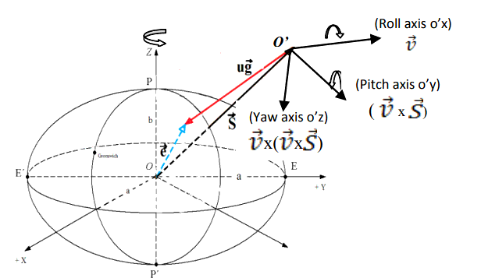
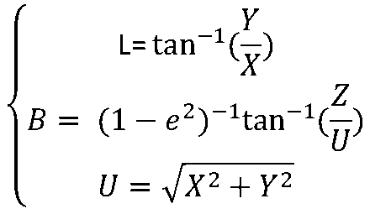
1.原理介绍
3. Mapping
Earth-Centered-Earth-Fixed (ECEF) Coordinate System
使用Bowring方法（Bowring，1985年）将ECEF坐标转换为大地纬度L和经度坐标B
L:大地经度
B:大地纬度
再将其L,B,H=110km 转化为地理坐标系下经纬度即可
9

Slide 10
2.程序包介绍
auromat 1.0.8 运行环境:Python2.6.X-2.7.X
Installation under Linux
Before installing auromat, some system libraries have to be installed：
sudo apt-get install libraw-dev liblensfun-dev libgeos-dev
If you want to use THEMIS data or export in CDF format you have to install NASA’s CDF library:
wget http://cdaweb.gsfc.nasa.gov/pub/software/cdf/dist/cdf35_0_2/linux/cdf35_0-dist-cdf.tar.gz
tar xf cdf35_0-dist-cdf.tar.gz
cdf35_0-dist make OS=linux ENV=gnu all
sudo make INSTALLDIR=/usr/local/cdf install
cd ..
Also, for using the CDF library in Python we need the spacepy library. Installation on Linux requires both a C and a Fortran compiler; a recent GCC is recommended (the C compiler is likely included with your distribution). On Debian and Ubuntu:
sudo apt-get install gfortran
SpacePy usually works with the system Python on Linux. To install dependencies via the package manager on Debian or Ubuntu:
sudo apt-get install python-dev python-h5py python-matplotlib python-networkx python-numpy python-scipy
10

Slide 11
2.程序包介绍
CDF
It is recommended to install the ncurses library; on Ubuntu and Debian:
sudo apt-get install ncurses-dev
Download the latest CDF library(http://cdf.gsfc.nasa.gov/). Choose the file ending in -dist-all.tar.gz from the linux directory. Untar and cd into the resulting directory. Then build:
make OS=linux ENV=gnu CURSES=yes FORTRAN=no UCOPTIONS=-O2 SHARED=yes all
sudo make install
ffnet
ffnet can be installed from pip; if the wrong Fortran compiler is found try:
pip install ffnet
If you want to export in netCDF format:
sudo apt-get install libnetcdf-dev libhdf5-serial-dev
If you want to draw any kind of geographic maps, install the basemap library with:
pip install --user --allow-external basemap --allow-unverified basemap basemap
11

Slide 12
2.程序包介绍
Now, install auromat with:
pip install --user auromat[cdf,netcdf]
Support for CDF or netCDF can be left out using auromat[cdf] or auromat[netcdf], respectively.
The command-line tools are installed in ~/.local/bin. For convenience you should add this folder to your PATH if that is not the case already:
export PATH=$HOME/.local/bin:$PATH
另外还需要安装
Astrometry.net(Astrometry.net)
Exiftool(ExifTool by Phil Harvey)
12

Slide 13
3.数据处理方法
例一（使用raw数据）
1.下载数据
$ mkdir /data/iss
$ cd/data/iss
$ auromat-download esa-iss --id 77
downloading https://.../api/georef_seqs/77-> done
downloading https://.../api/georef_seqs/77/metadata.json-> done
downloading https://.../data/bad_pixels/ISS030-E/122500/ISS030-E_26_badpixels.gz-> done
downloading https://.../data/img/ISS030-E/122500/ISS030-E-122539.nef-> done
downloading https://.../data/wcs/ISS030-E/122500/ISS030-E-122539_25738.wcs-> done
...
downloading https://.../data/img/ISS030-E/123000/ISS030-E-123010.nef-> done
downloading https://.../data/wcs/ISS030-E/123000/ISS030-E-123010_26209.wcs-> done Done.
2.格式转换
.nef文件是原始RAW相机文件，而.wcs文件包含对它们进行地理配准所需的元数据。
现在，我们使用auromat转换工具将下载的数据转换为易于使用的标准格式：
$ auromat-convert --data seq-77 --format cdf
3.数据调用
>>> from auromat.mapping.iss import ISSMappingProvider
>>> provider = ISSMappingProvider('/data/iss/seq-77', altitude=110, raw_auto_bright=True, raw_gamma=None)
>>> provider.range (datetime.datetime(2012, 3, 4, 17, 18, 54), datetime.datetime(2012, 3, 4, 17, 26, 45))
13

Slide 14
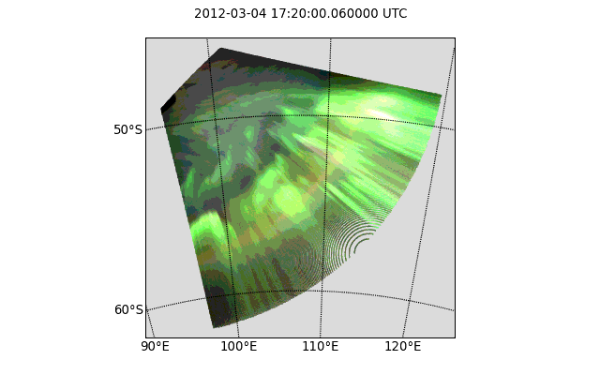
3.数据处理方法
4.选择具体图片并定位
>>> from datetime import datetime >>> mapping = provider.get(datetime(2012, 3, 4, 17, 20, 0))
>>> mapping.metadata['mission'], mapping.metadata['frame'] (u'ISS030', 122605)
>>> mapping.boundingBox
BoundingBox(latSouth=-62.190843, lonWest=95.411578, latNorth=-45.961958, lonEast=120.28385)
>>> mapping.arcSecPerPx.width
PixelScale(mean=7.9593521008, median=6.1537259006, min=4.0048511309, max=156.57782882)
5.采样（为了在地图上可视化地理参考图像，我们必须先对其进行下采样，否则matplotlib将被绘制的多边形数量所淹没）
>>> from auromat.resample import resample
>>> resampled = resample(mapping, arcsecPerPx=100)
>>> resampled.arcSecPerPx.width
PixelScale(mean=102.525998960, median=103.801386204, min=81.2014140, max=119.10222026)
>>> resampled.arcSecPerPx.height
PixelScale(mean=100.093068376, median=100.088951928, min=100.0108325, max=100.18487082)
6.成像
>>> import auromat.draw as draw
>>> from auromat.draw import saveFig
>>> saveFig('map.png', draw.drawStereographic(resampled))
14

Slide 15
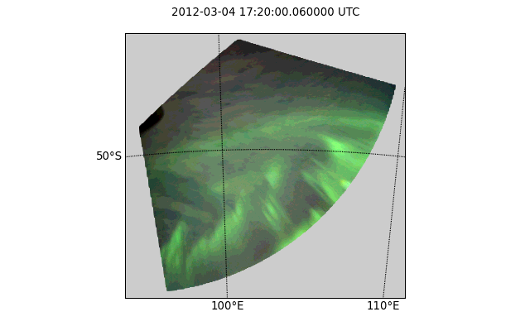
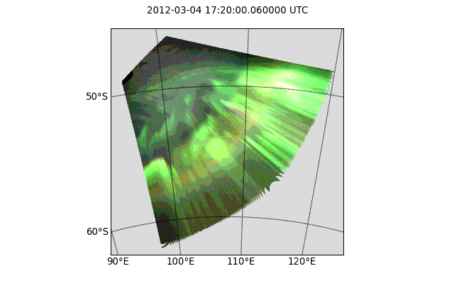
3.数据处理方法
>>> resampled = resample(mapping, arcsecPerPx=100, method='nearest')
>>> saveFig('map.png', draw.drawStereographic(resampled))
但是，一般不应使用非默认重采样方法（例如上面的方法），因为它们会插值或外推值。 由于地平线附近的区域无论如何都没有科学上的用处（由于低仰角和由此产生的透视误差），一种更好的方法是通过给定的最小仰角掩盖地图
图像中的圆孔是由重采样算法引起的，默认情况下，该算法是简单直接的重合并。地平线附近的未重采样像素的比例非常高，这意味着仅存在很少的数据点，这对于重新合并意味着当不存在目标像素的数据点时将出现空洞。
通过使用不同的重采样方法，可以防止这种影响：
>>> resampled = resample(mapping, arcsecPerPx=100)
>>> masked = resampled.maskedByElevation(10)
>>> saveFig('map.png', draw.drawStereographic(masked))
15

Slide 16
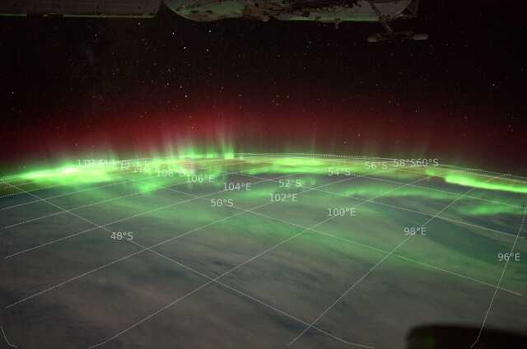
3.数据处理方法
另一种方法的可视化映射是在原始图像的顶部绘制坐标网格：
>>> saveFig('map.png', draw.drawParallelsAndMeridians(mapping))
16

Slide 17
3.数据处理方法
例二（使用JPEG)
1.下载数据
4.确定拍摄图像时ISS的位置,映射
>>> from auromat.solving.eol import downloadImageSequence
>>> imgfolder = '/data/iss_imgs'
>>> metadata, failures = downloadImageSequence(imgfolder, 'ISS040', 64750, 64770, 'jpg')
downloading sequence frames 64750 to 64770 of ISS040-E
downloading http://eol.jsc.nasa.gov/DatabaseImages/ESC/large/ISS040/ISS040-E-64750.JPG-> done
...
downloading http://eol.jsc.nasa.gov/DatabaseImages/ESC/large/ISS040/ISS040-E-64770.JPG-> done
>>> failures
[]
>>> from auromat.mapping.spacecraft import SpacecraftMappingProvider
>>> from auromat.resample import resample
>>> from auromat.draw import saveFig
>>> import auromat.draw as draw
>>> provider = SpacecraftMappingProvider(dcfolder, wcsfolder)
>>> provider.range (datetime.datetime(2014, 7, 15, 10, 21, 3), datetime.datetime(2014, 7, 15, 10, 21, 43, 60000))
>>> mapping = provider.getById('64750') # id = any unique part of the filename
>>> resampled = resample(mapping, arcsecPerPx=100)
>>> masked = resampled.maskedByElevation(10)
>>> saveFig('map.png', draw.drawStereographic(masked))
2.校正镜头失真
>>> from auromat.solving.eol import correctLensDistortion
>>> dcfolder = '/data/iss_imgs_dc'
>>> correctLensDistortion(imgfolder, dcfolder)
NOTE: Using lensfun lens "Nikkor 50mm f/1.4D AF" with score 100 (EXIF: "AF Nikkor 50mm f/1.4D")
3.使用astrometry.net软件,获得的天文解
>>> from auromat.solving.spacecraft import solveSequence
>>> wcsfolder = '/data/iss_wcs'
>>> stuser, stpass = 'space-track-user', 'space-track-pass'
>>> noradid = 25544 # NORAD ID of ISS >>> tlefolder = '/data/tles' # location where orbit data from space-track.org is cached
>>> paths = List(solveSequence(dcfolder, wcsfolder, tlefolder, stuser, stpass, noradiss))
>>> Len(paths) == 21
True
17

Slide 18
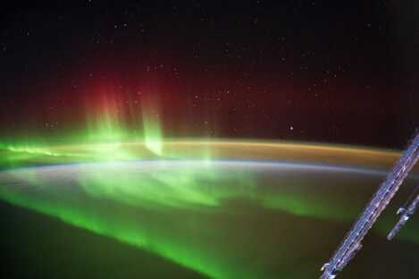
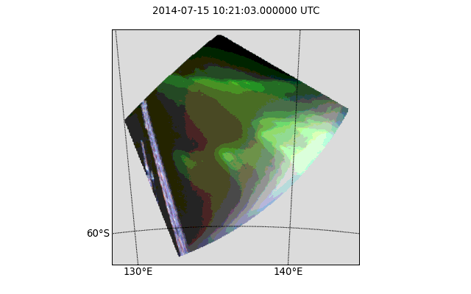
3.数据处理方法
结果
18

Slide 19
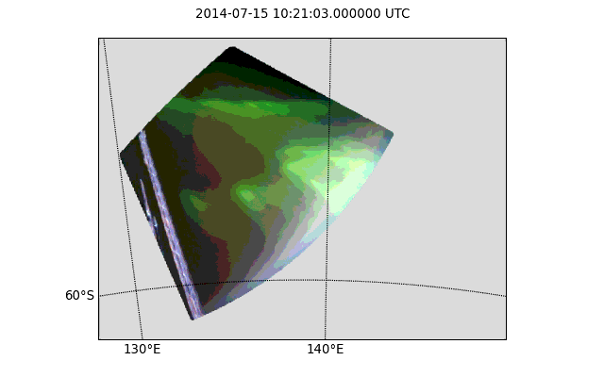
3.数据处理方法
动画
>>> from auromat.util.movie import createMovie
>>> moviepath = os.path.join(moviefolder, 'movie.mp4')
>>> createMovie(moviepath, mappaths, frameRate=3)
19

Slide 20
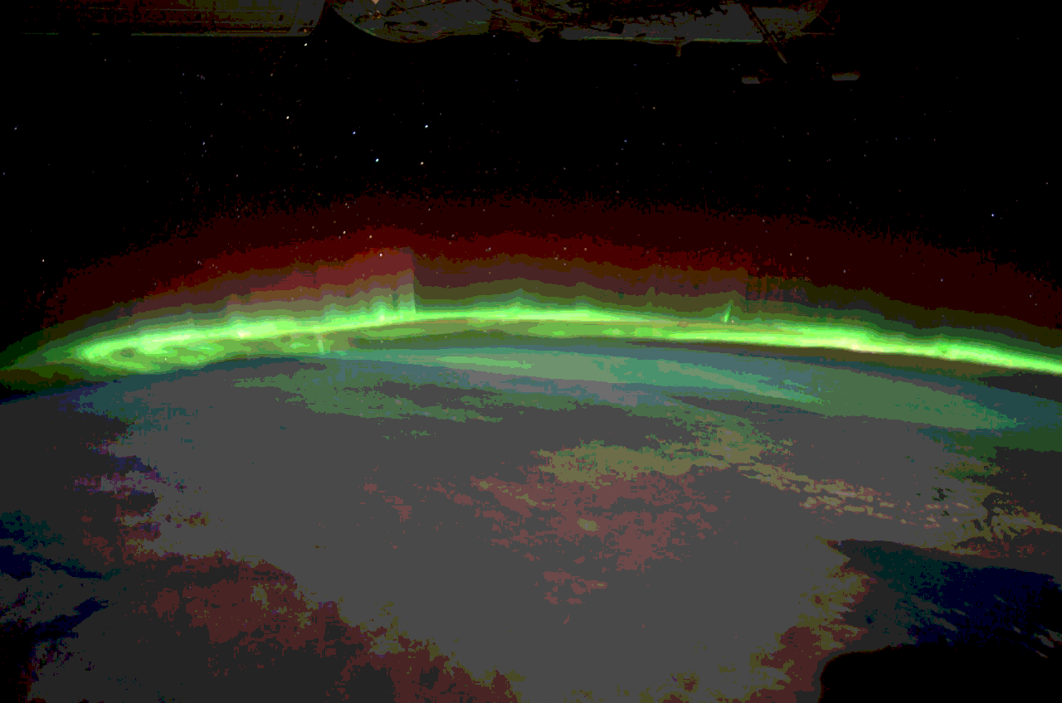
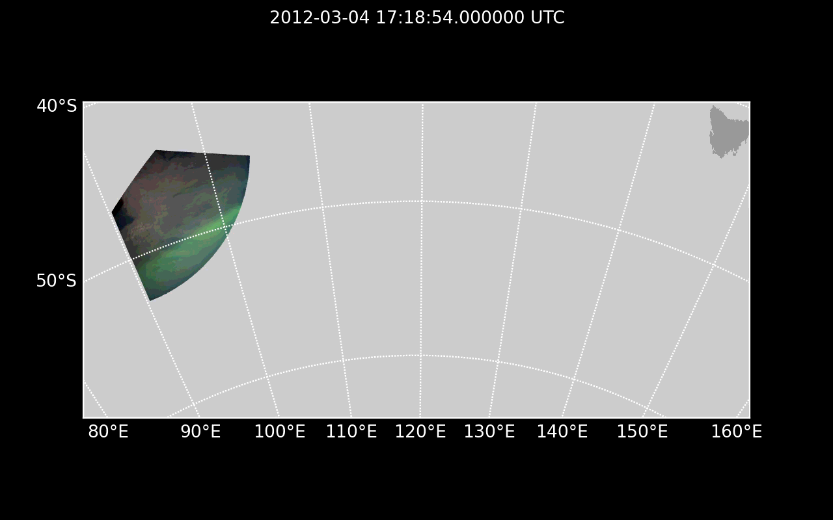
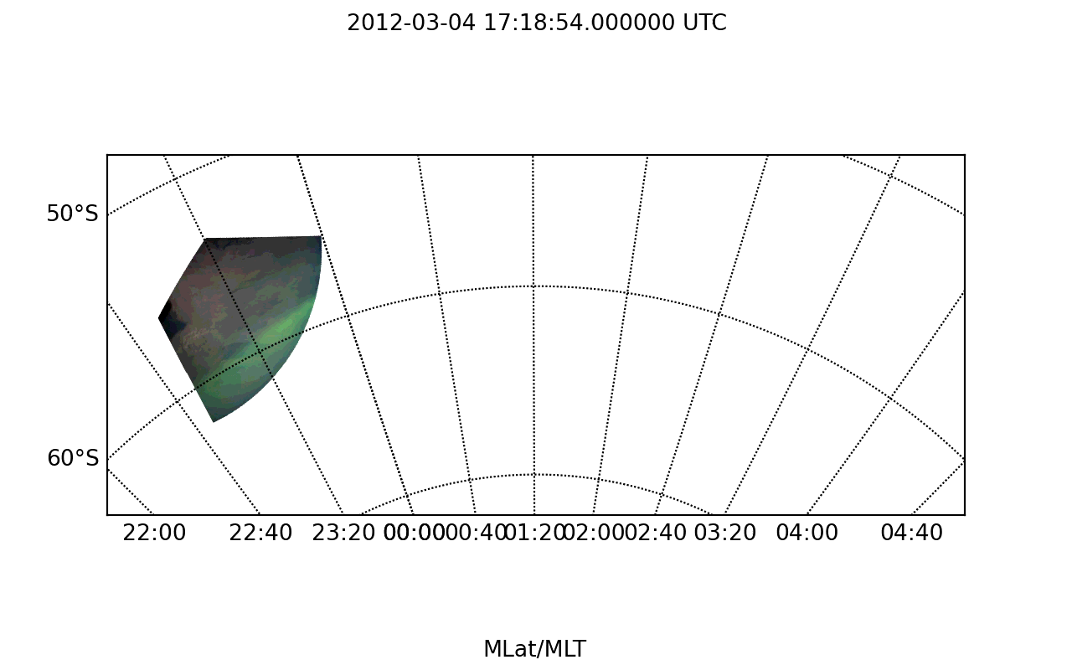
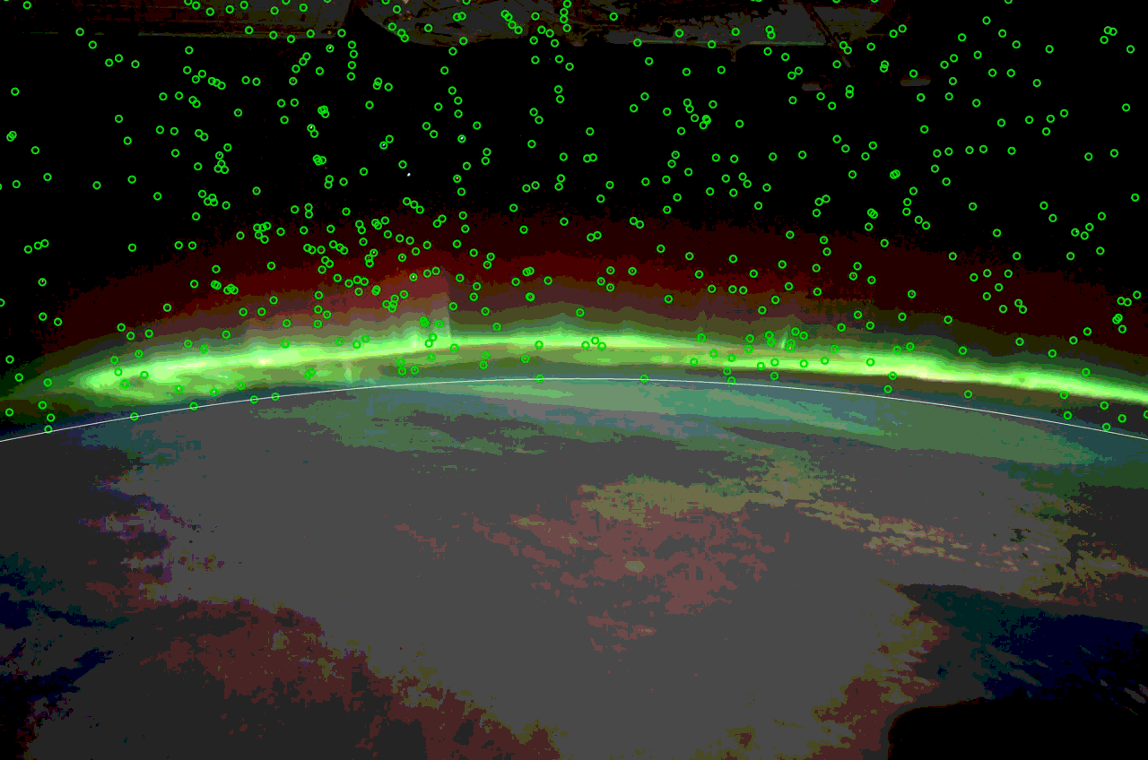
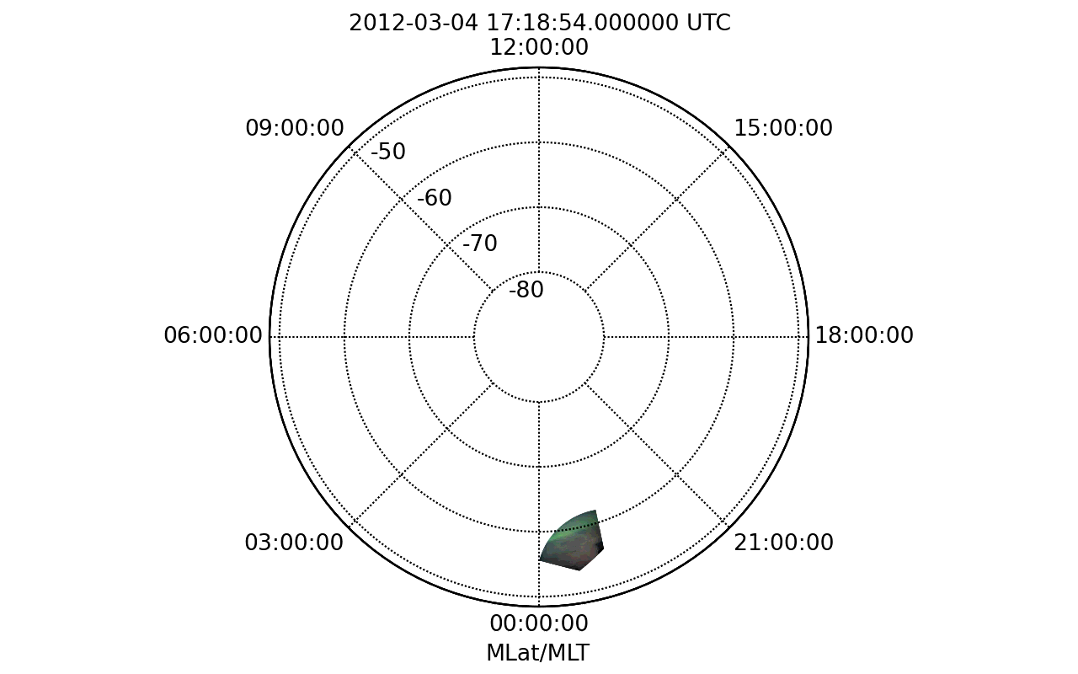
3.数据处理方法
一些具体例子
2012-03-04 17:18:54-17:26:45
20

Slide 21
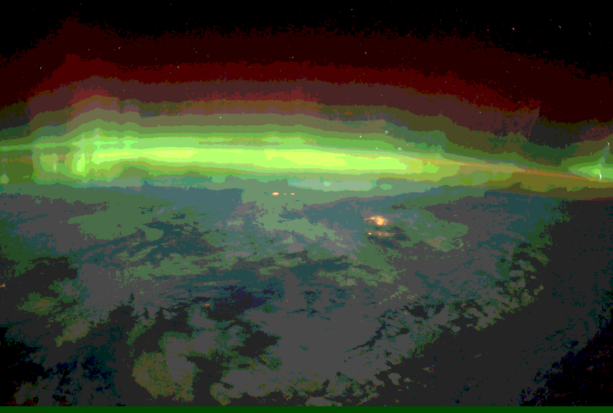
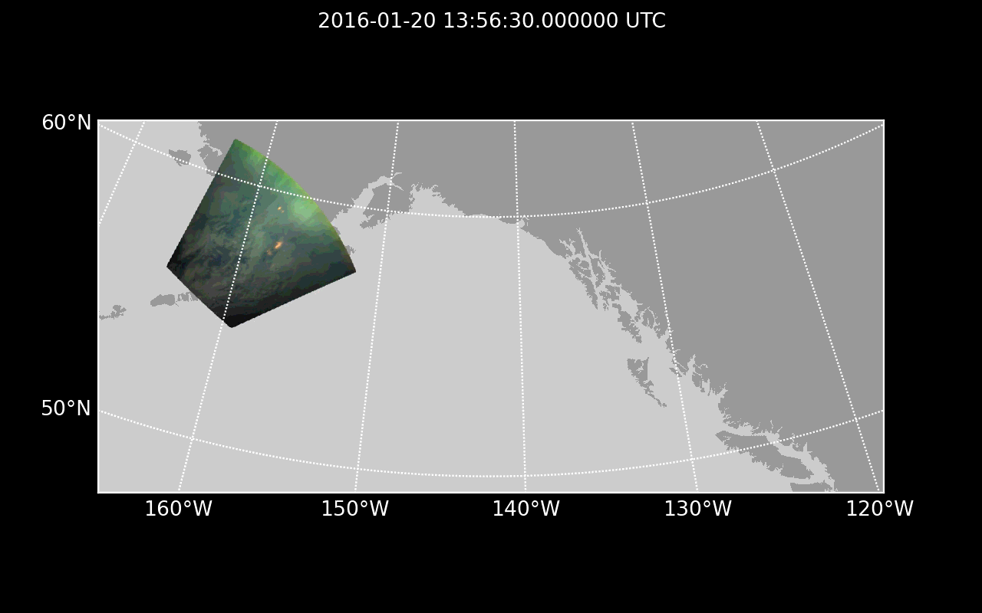
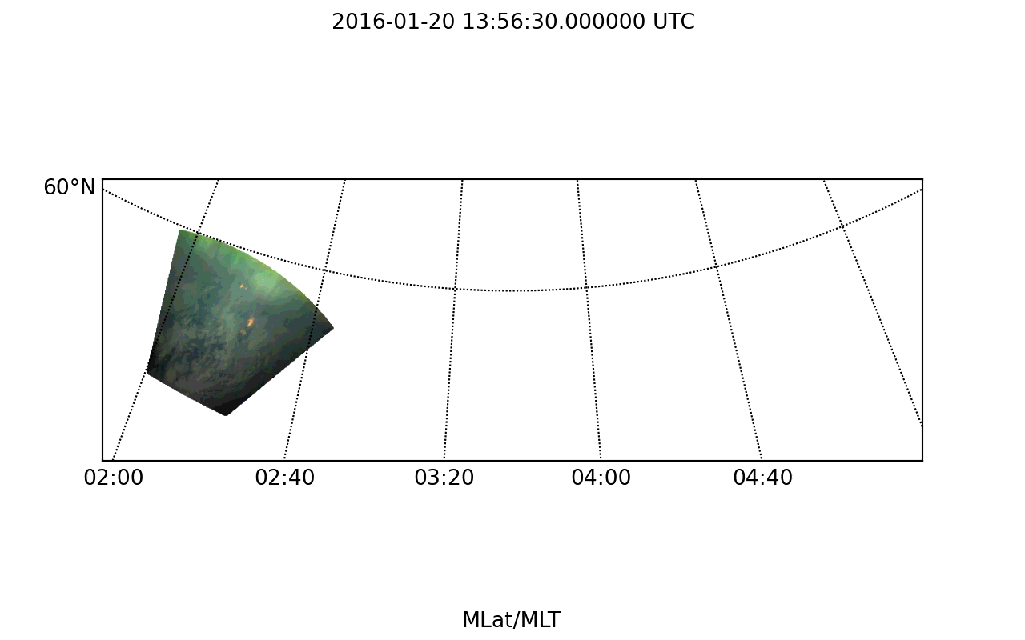
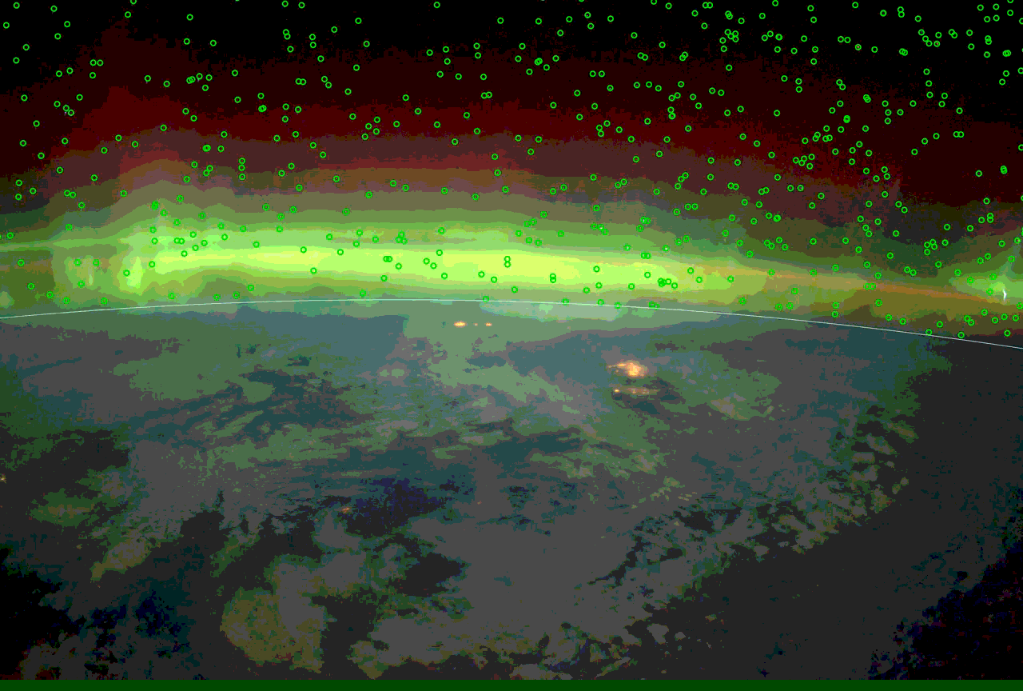
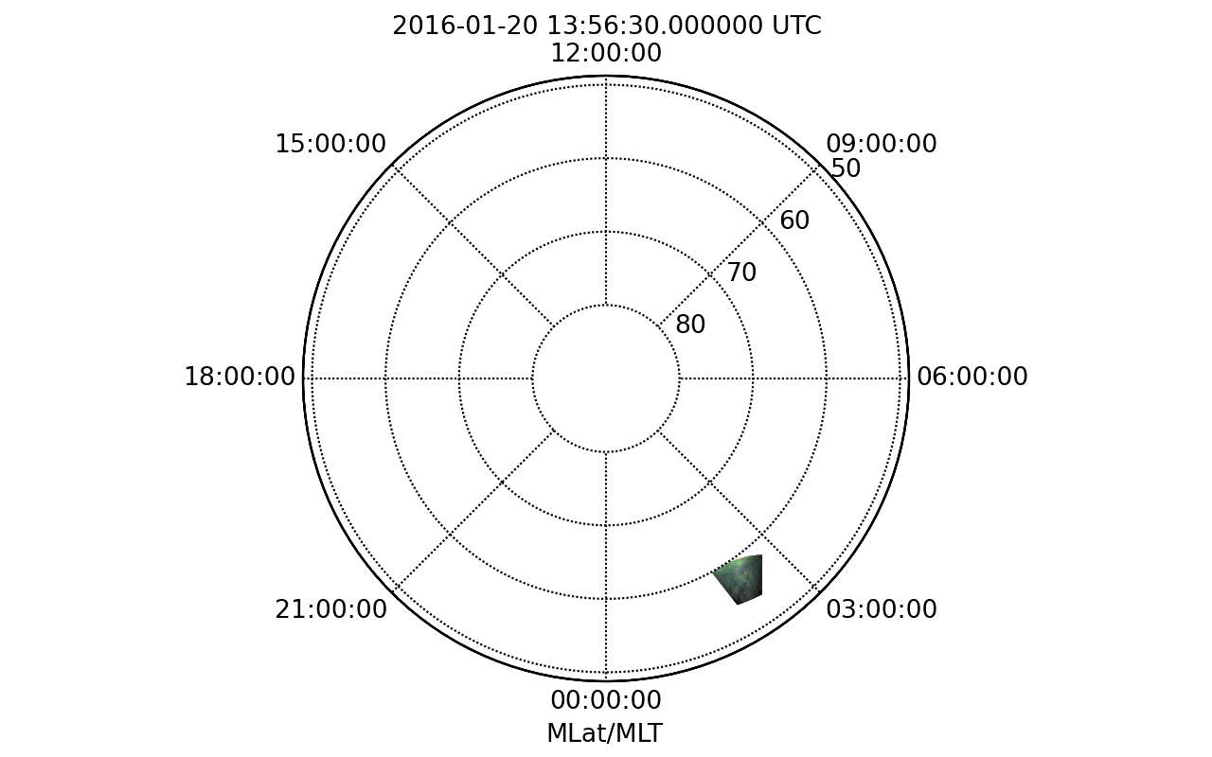
3.数据处理方法
2016-01-20 13:56:30-14:01:52
21

Slide 22
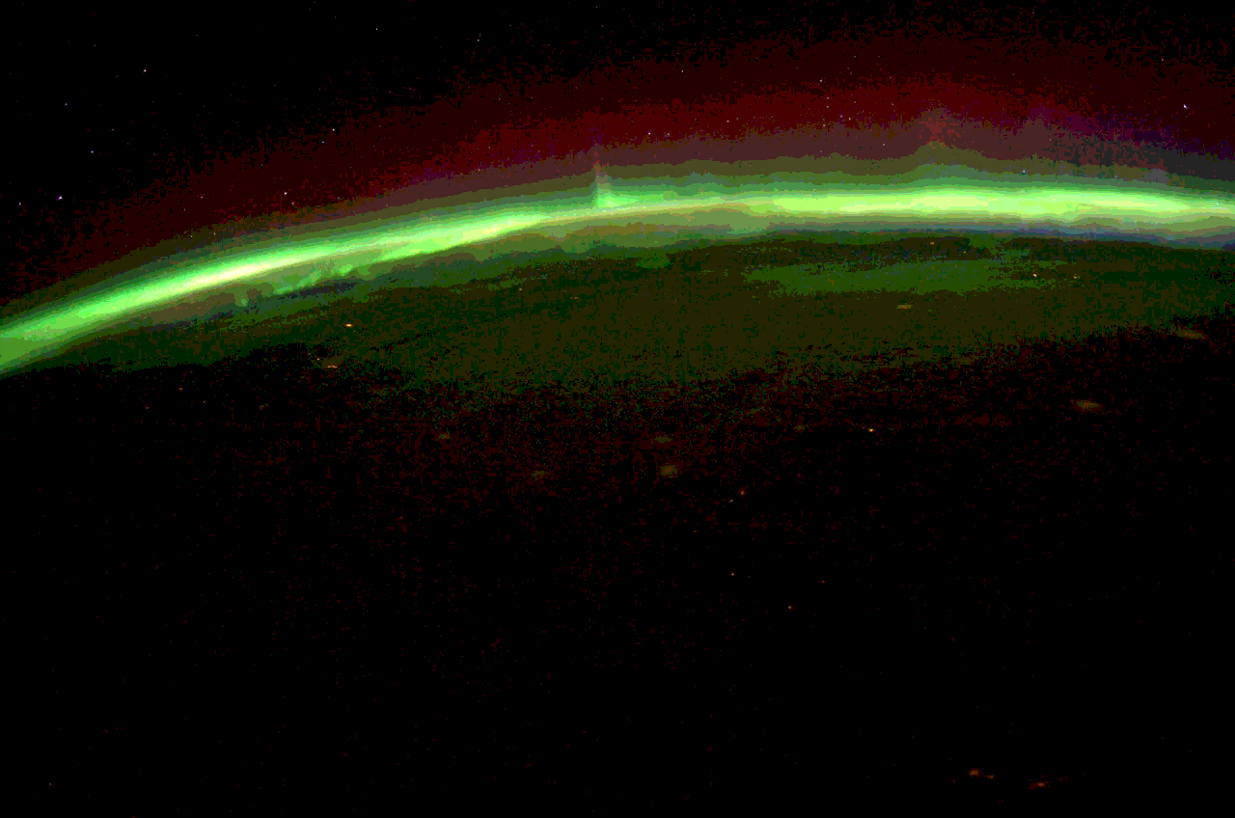
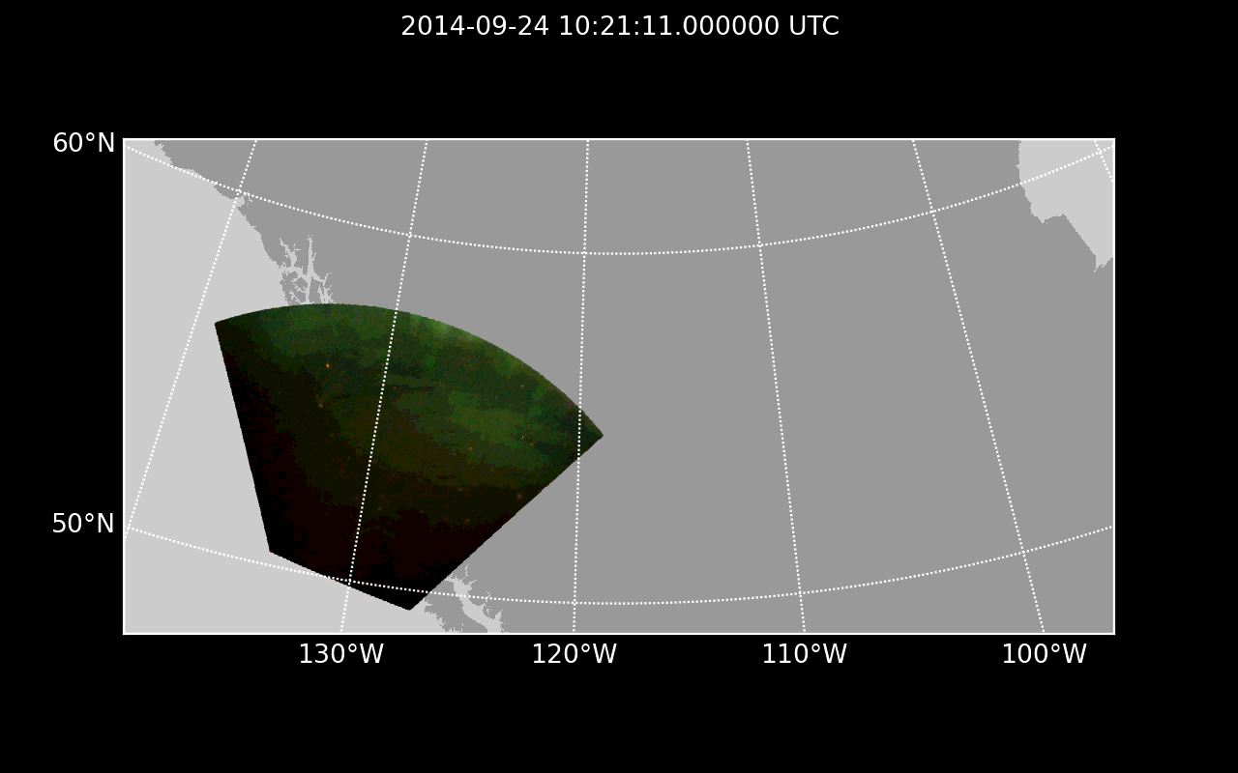
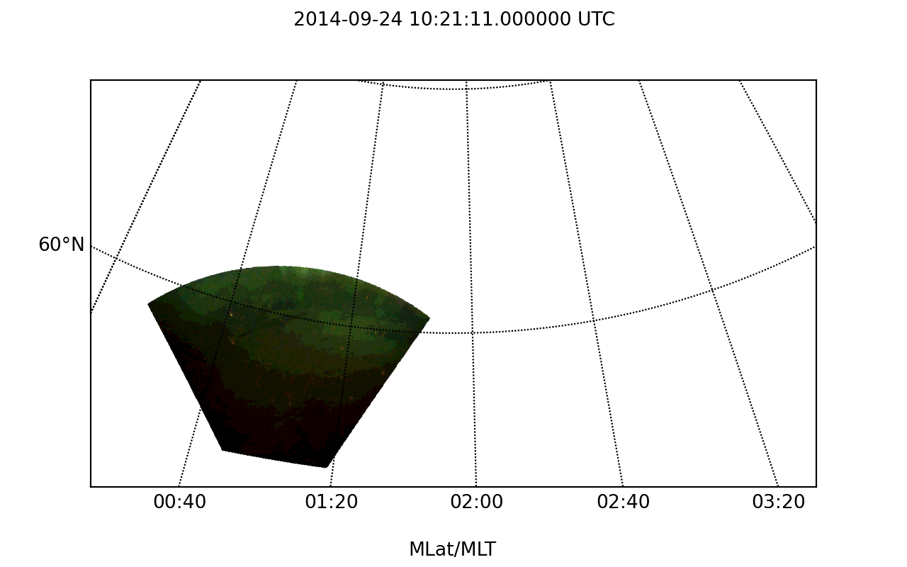
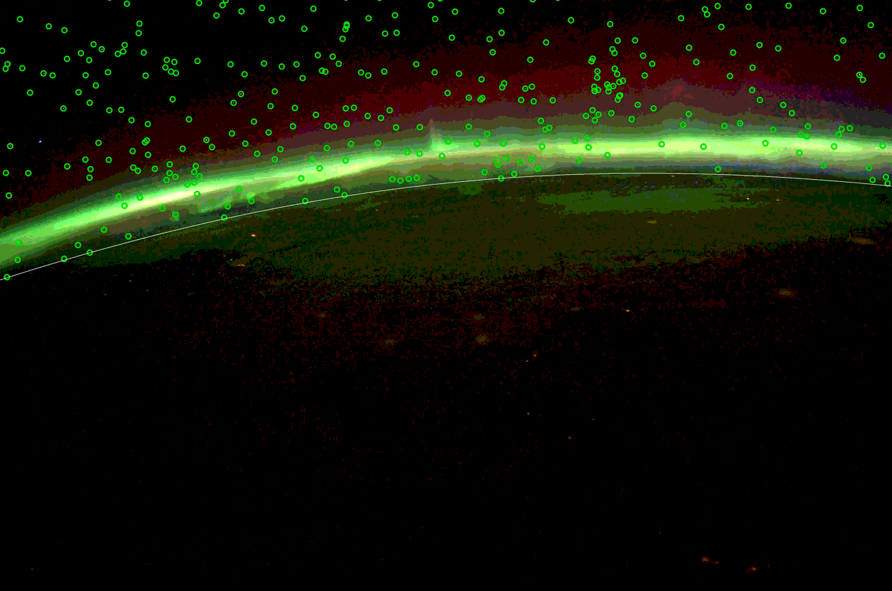
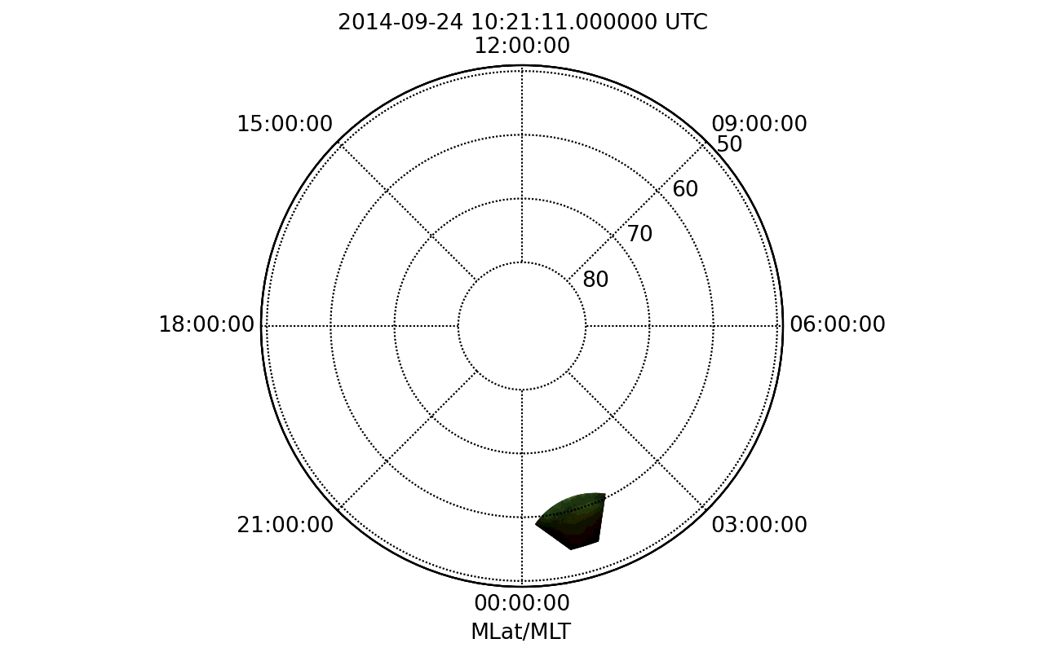
3.数据处理方法
2014-09-24 10:21:11-10:24:31
22

Slide 23
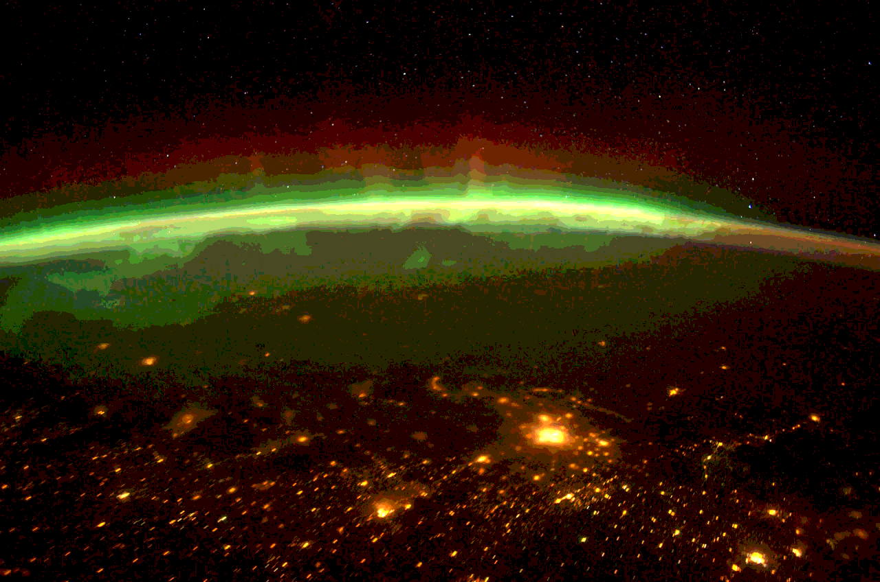
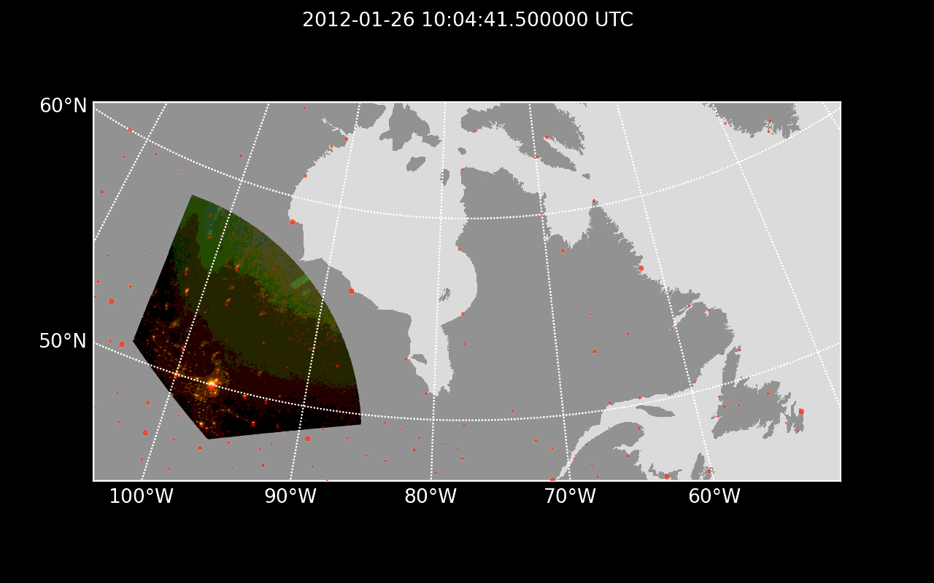
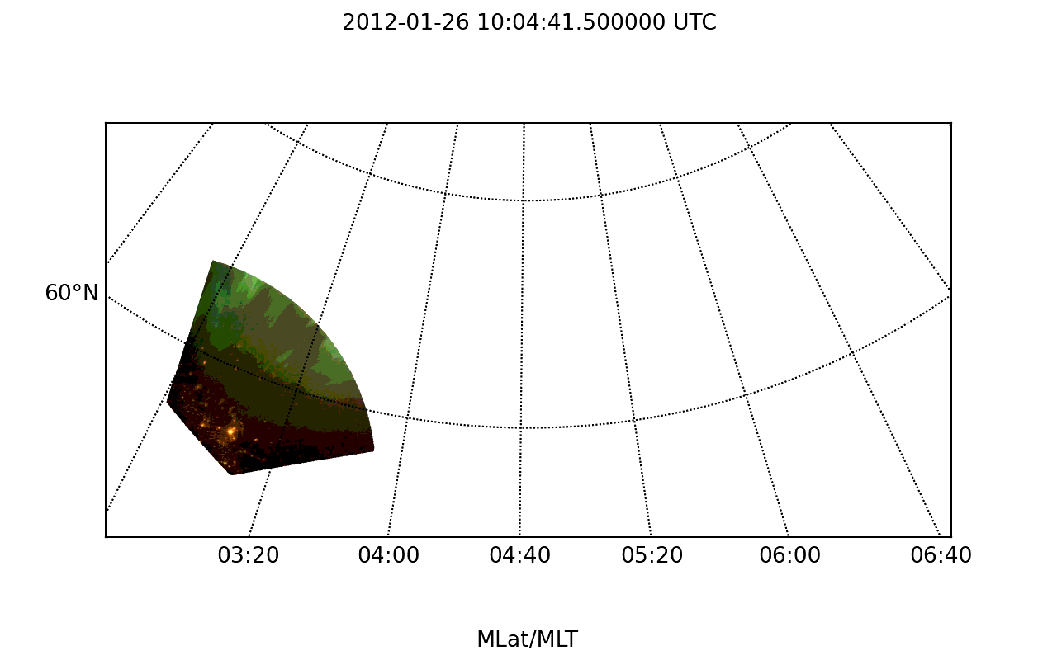
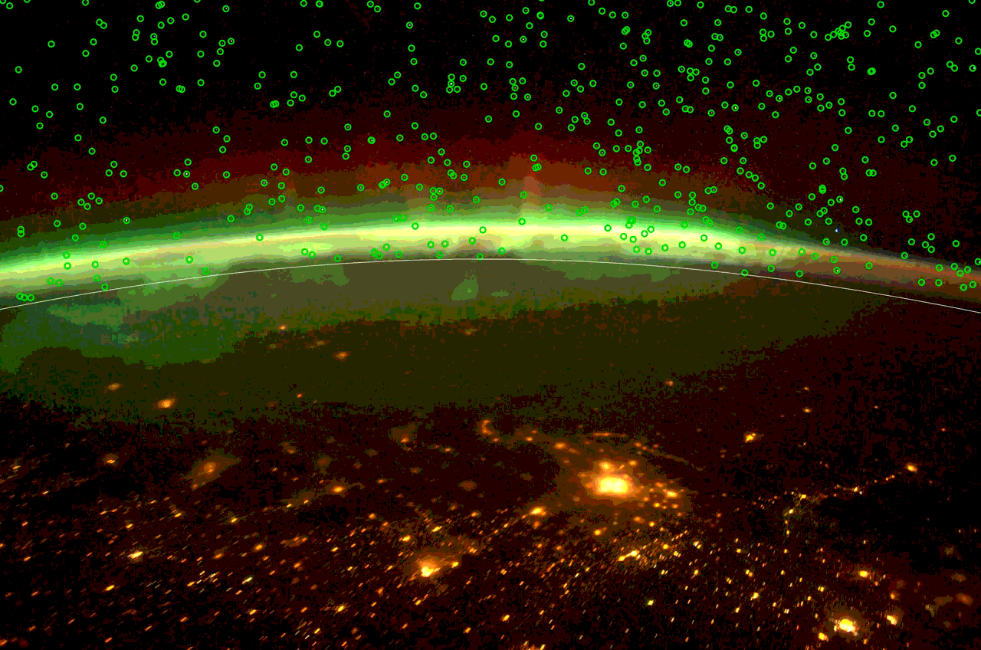
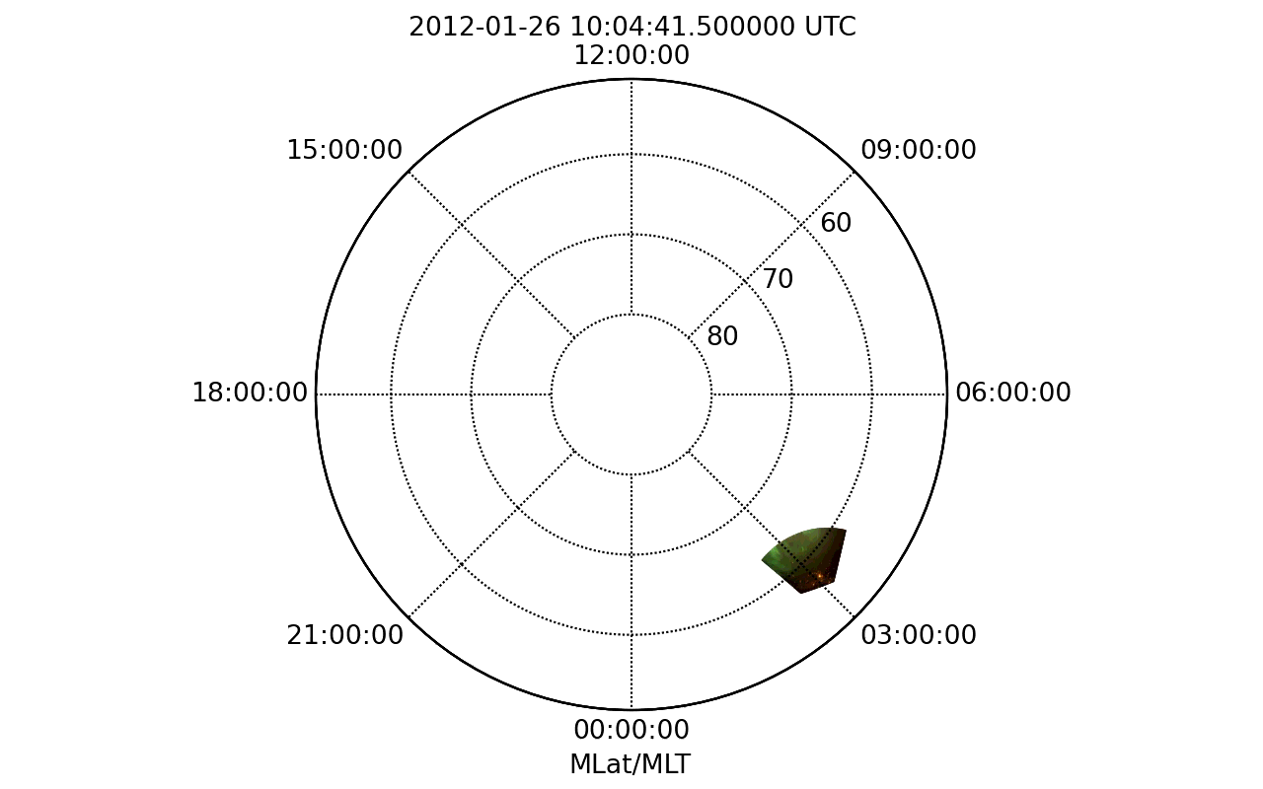
3.数据处理方法
2012-01-26 10:04:41.5-10:10:27.5
23

Slide 24
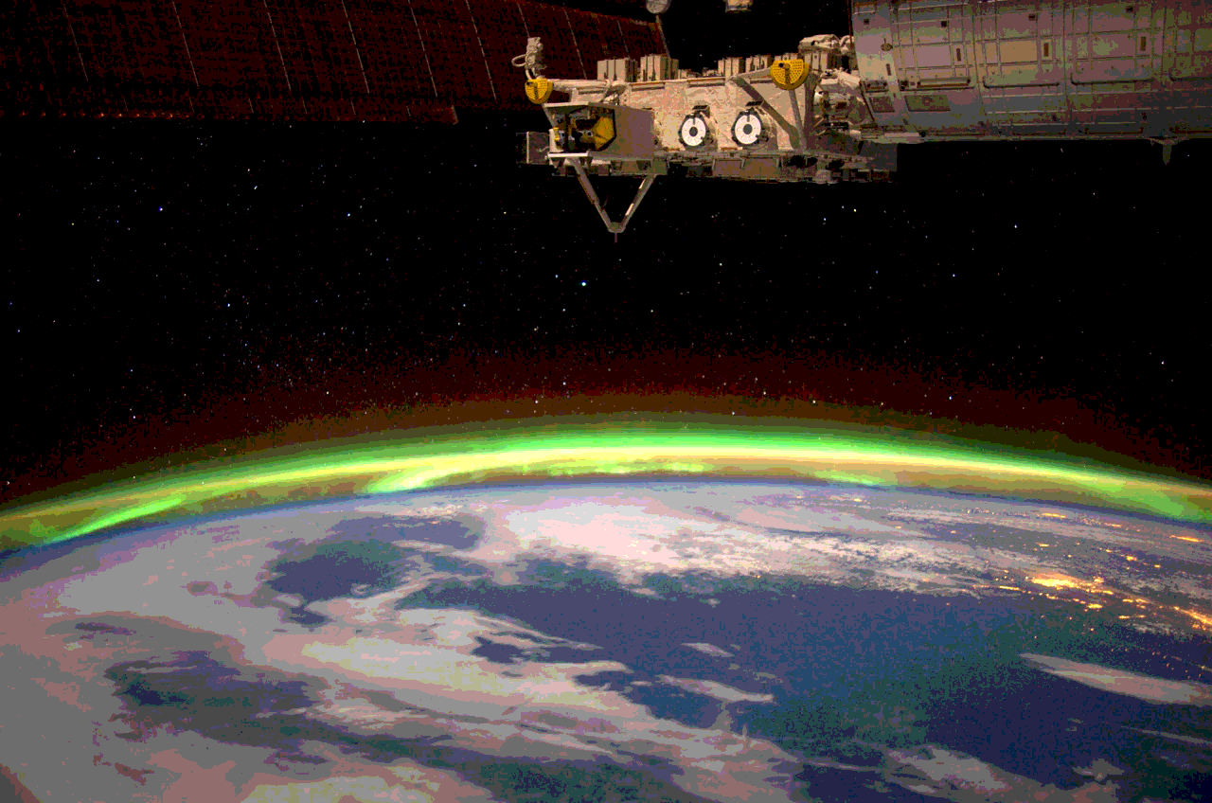
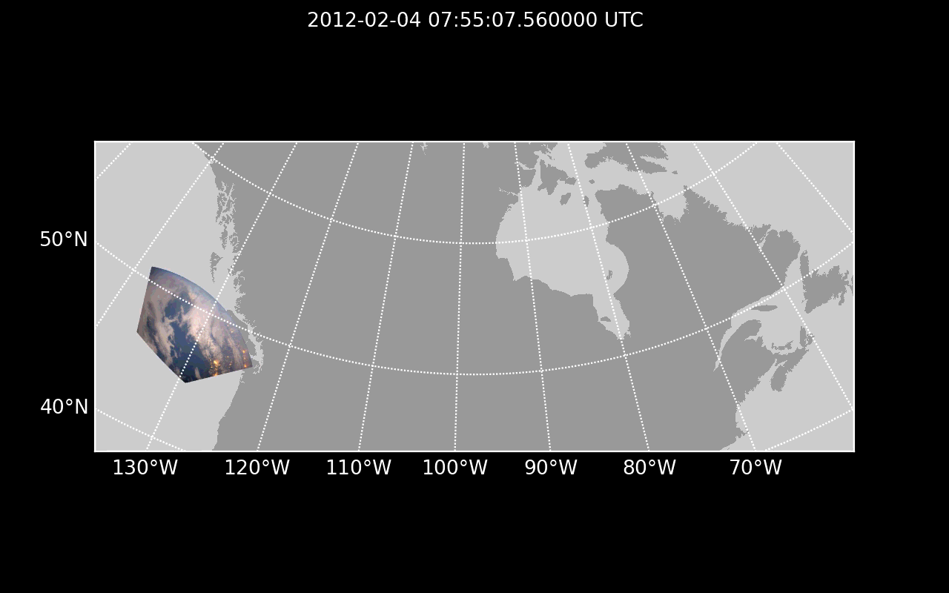
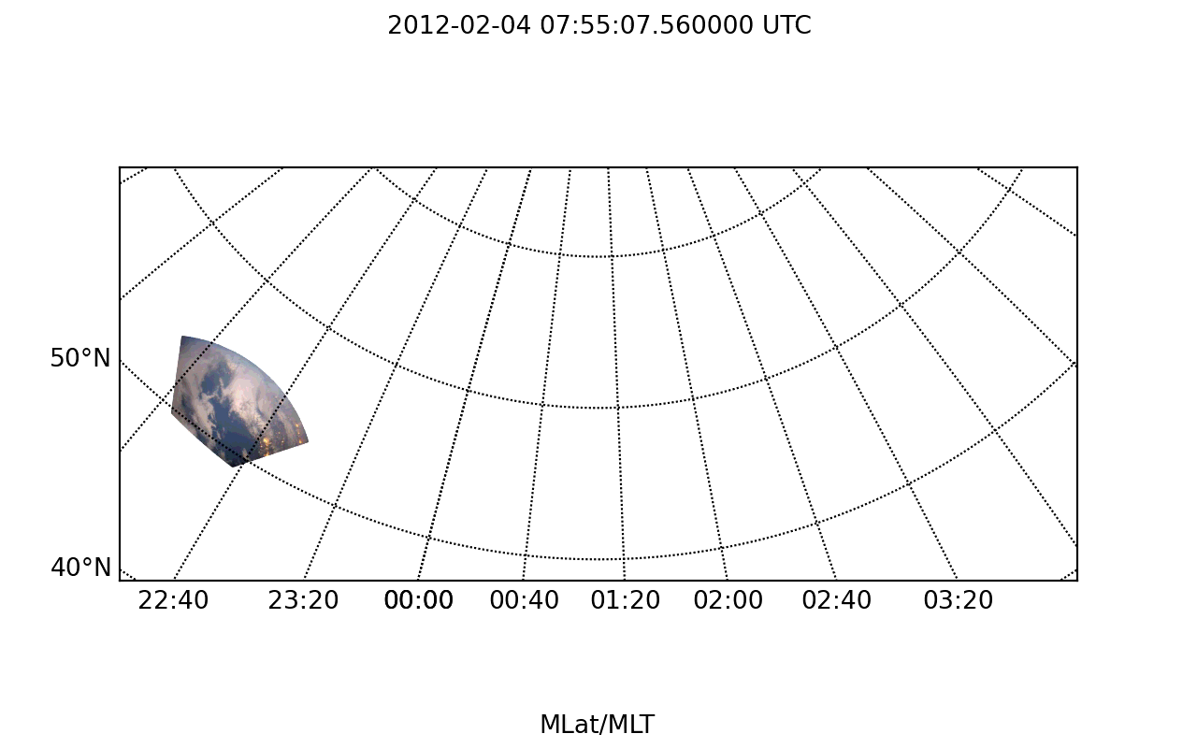
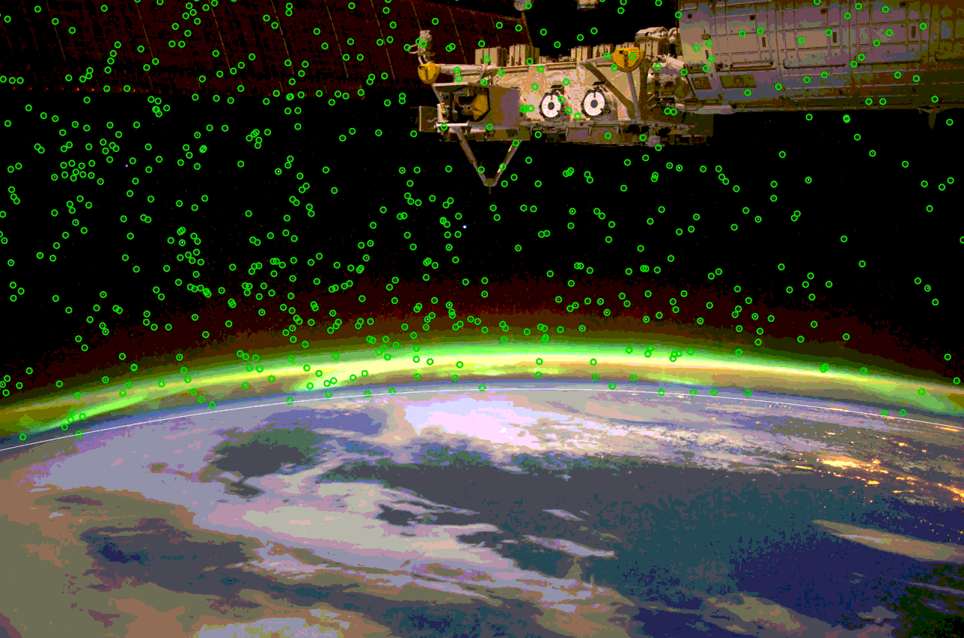
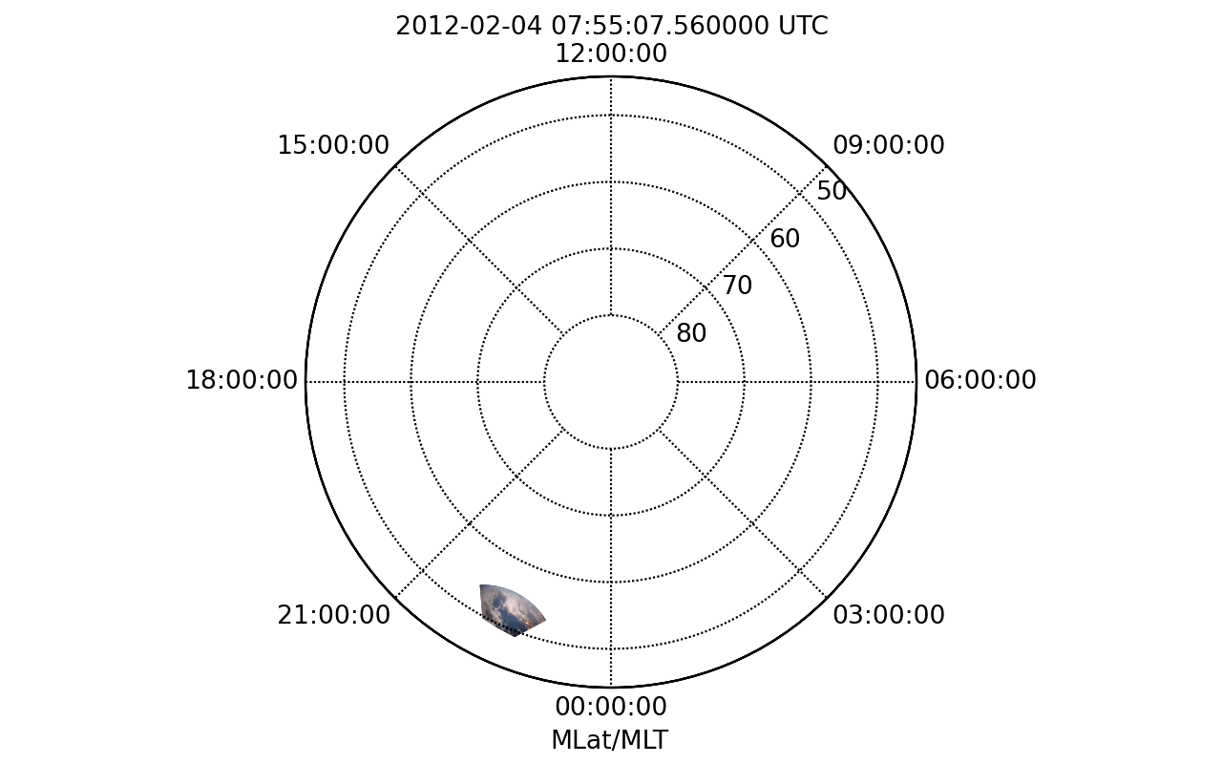
3.数据处理方法
2012-02-04 07:55:07.56-08:06:20.5
24

Slide 25
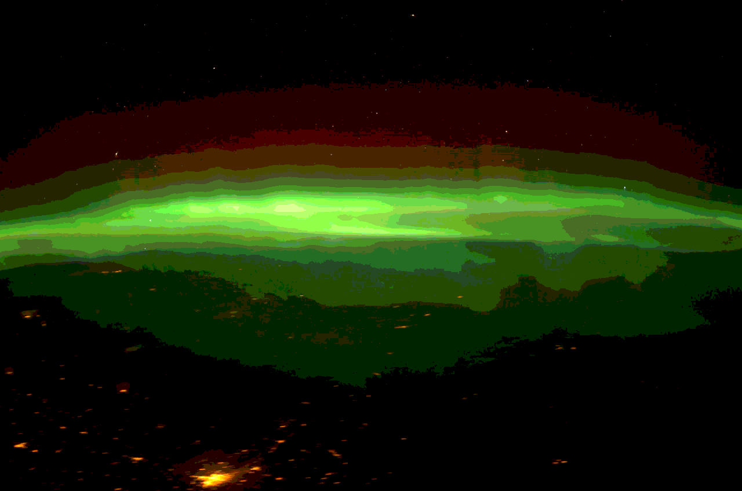
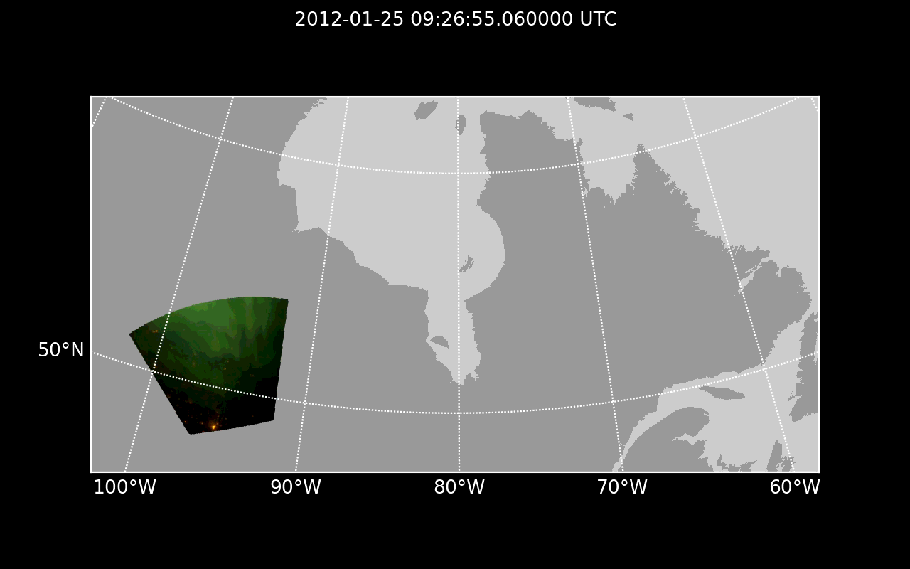
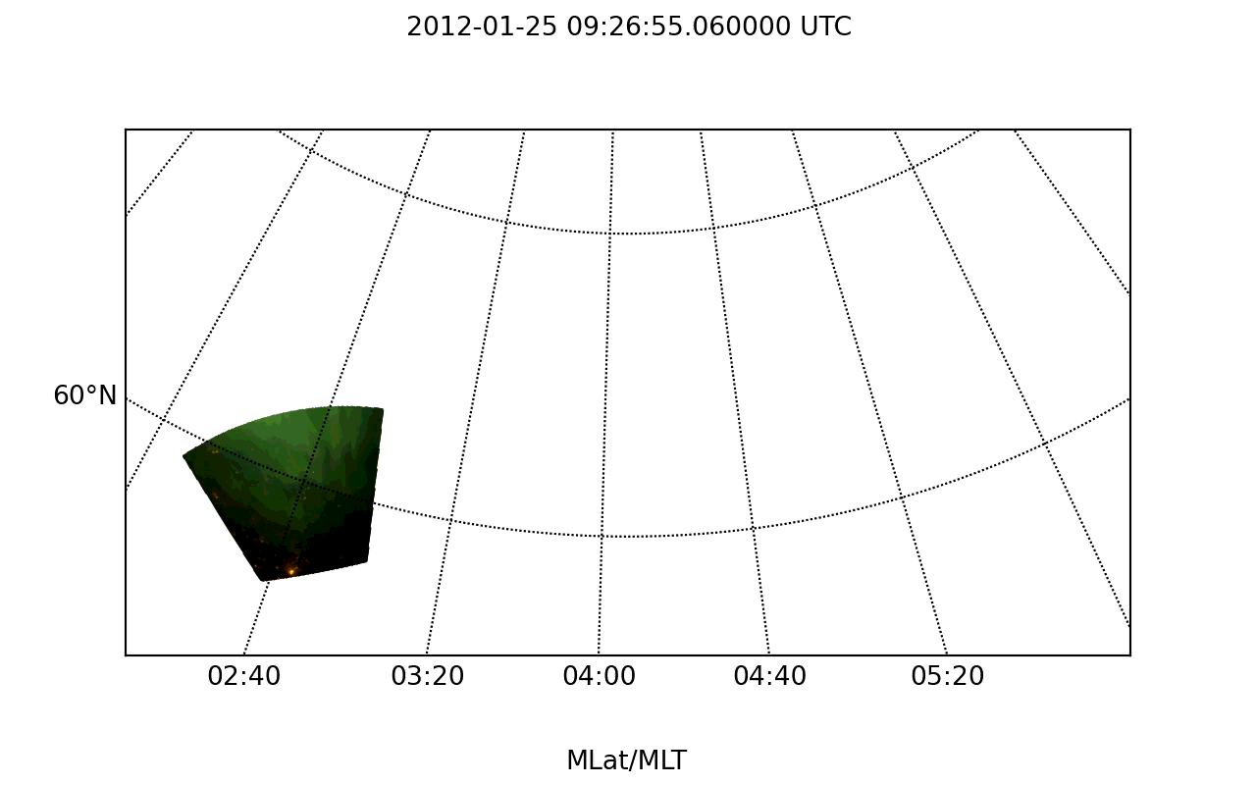
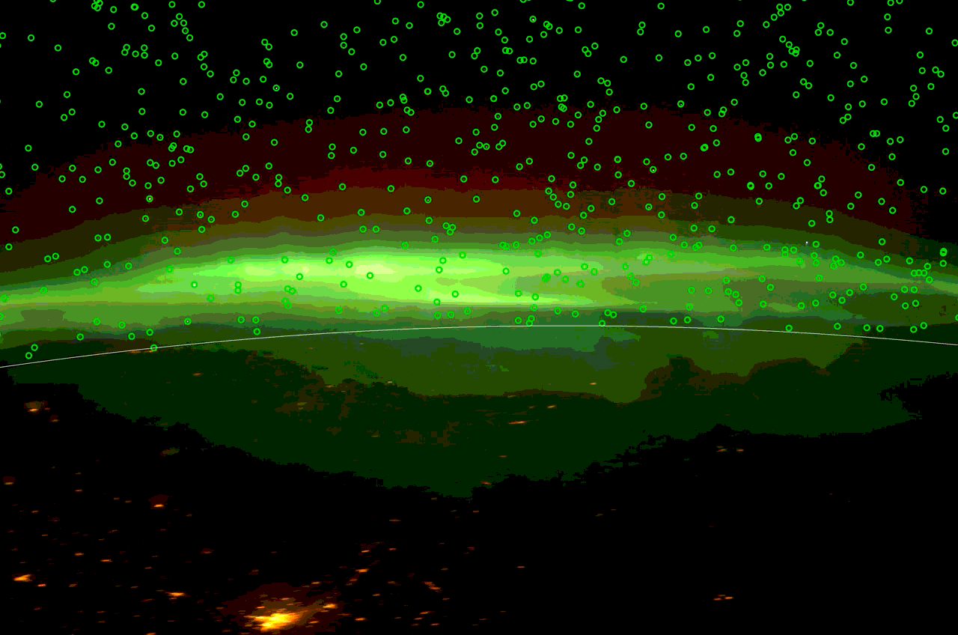
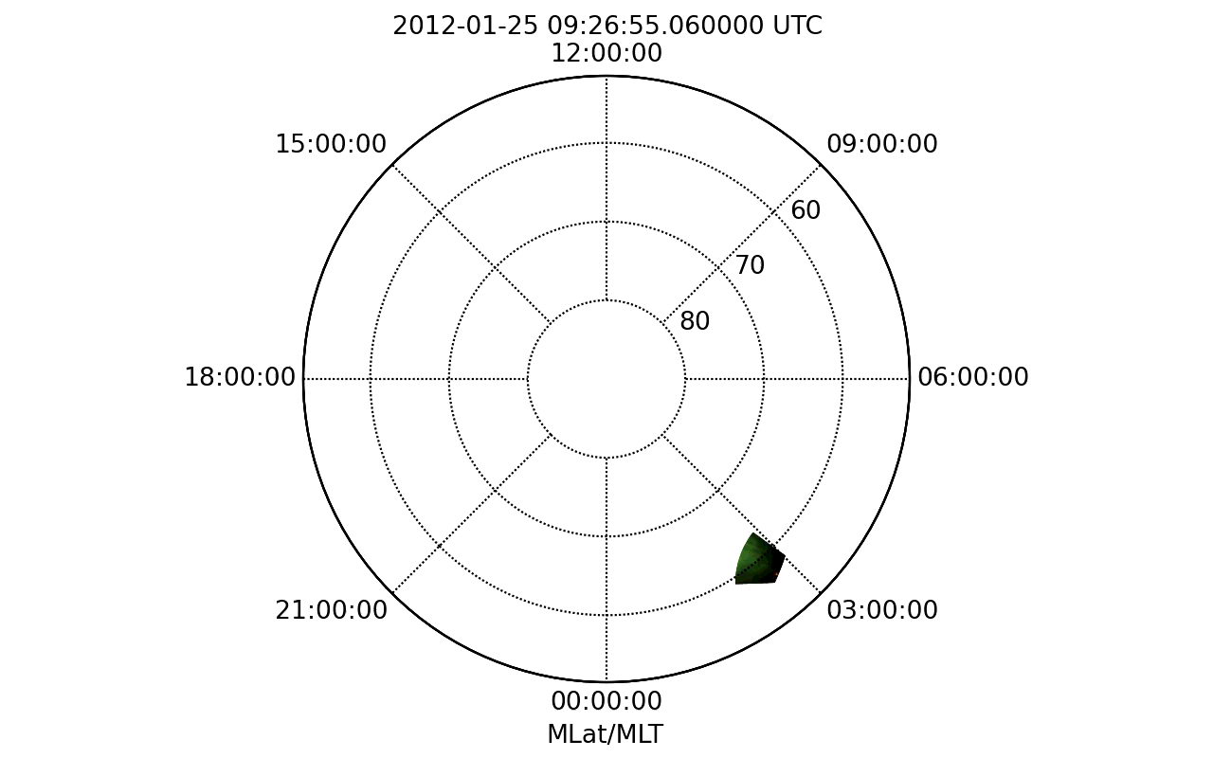
3.数据处理方法
2012-01-25 09:26:55.06-09:31:57.06
25

Slide 26
3.数据处理方法
接下来的工作
1.误差分析，对参考星和提取星的位置进行比对。如果很少重合，说明镜头变形轮廓不正确或窗口变形
2.分析轨道对校准星提取的影响
26

Slide 27
4.参考文献
Nanjo, S., Hozumi, Y., Hosokawa, K., Kataoka, R., Miyoshi, Y., & Oyama, S.-i. (2020). Fine-scale visualization of aurora in a wide area using color digital camera images from the International Space Station. Journal of Geophysical Research: Space Physics, 125, e2019JA027729.
Mende, S. B., Harris, S. E., Frey, H. U., Angelopoulos, V., Russell, C. T., Donovan, E., et al. (2008). The themis array of ground-based
observatories for the study of auroral substorms. Space Science Reviews, 141(1-4), 357. https://doi.org/10.1007/s11214-008-9380-x
Hozumi, Y., Saito, A., & Ejiri, M. K. (2016). Calibration of imaging parameters for space-borne airglow photography using city light positions. Earth, Planets and Space, 68(1), 155. https://doi.org/10.1186/s40623-016-0532-z
POPESCU G. Pixel geolocation algorithm for satellite scanner data[J]. Scientific Papers. Series E. Land Reclamation, Earth Observation & Surveying, Environmental Engineering, Vol. III, Bucharest, 2014: 127-136.
Riechert M, Walsh A P, Gerst A, et al. Automatic georeferencing of astronaut auroral photography[J]. Geoscientific Instrumentation, Methods and Data Systems, 2016, 5(2): 289-304.
Jung H S, Kim S W, Won J S, et al. Line-of-sight vector adjustment model for geopositioning of SPOT-5 stereo images[J]. Photogrammetric Engineering & Remote Sensing, 2007, 73(11): 1267-1276.
27

